Slide 1
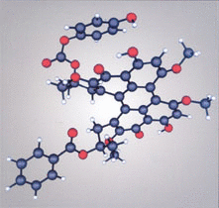
Lecture 10. Beyond Homonuclear Diatomics

Slide 2
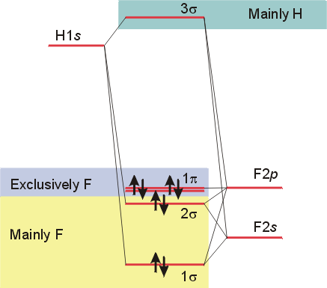
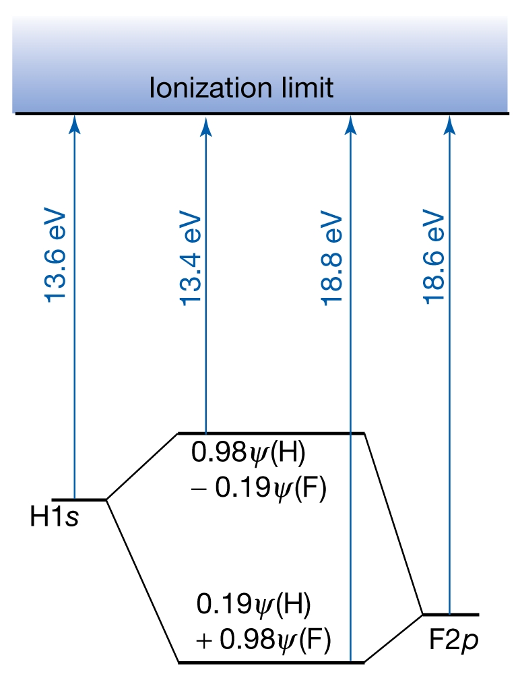
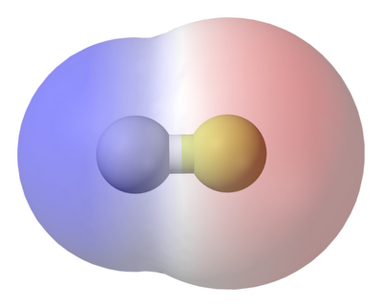
Heteronuclear Diatomics: HF
Higher electronegativity of F: Lopsided electron distribution
Bonding and antibonding MOs: s as well as p
Unequal contribution from the two atoms

Slide 3
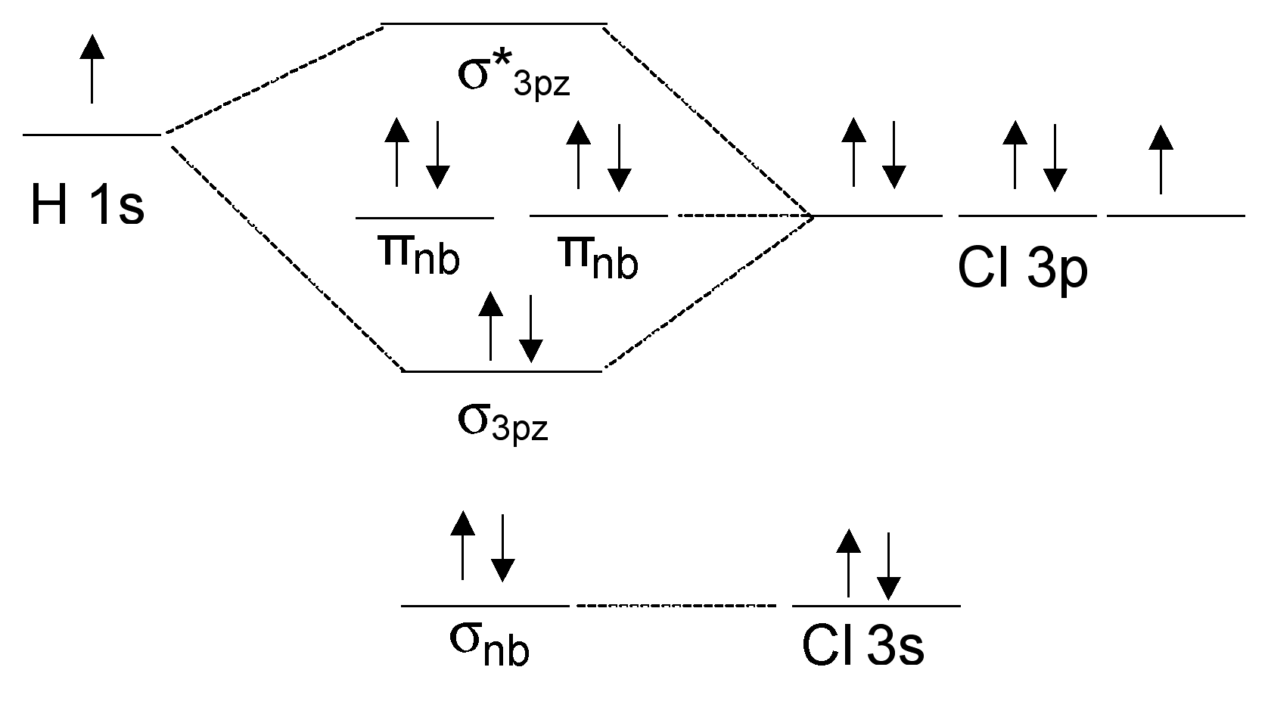
Heteronuclear Diatomics: HCl
For Cl 3p states close in energy to the 1s of H

Slide 4
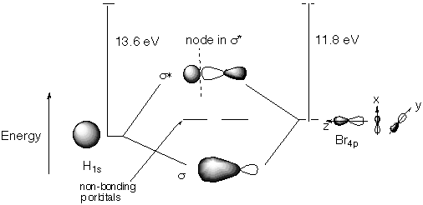
Heteronuclear Diatomics: HBr
For Br 4p states close (higher) in energy to the 1s of H

Slide 5
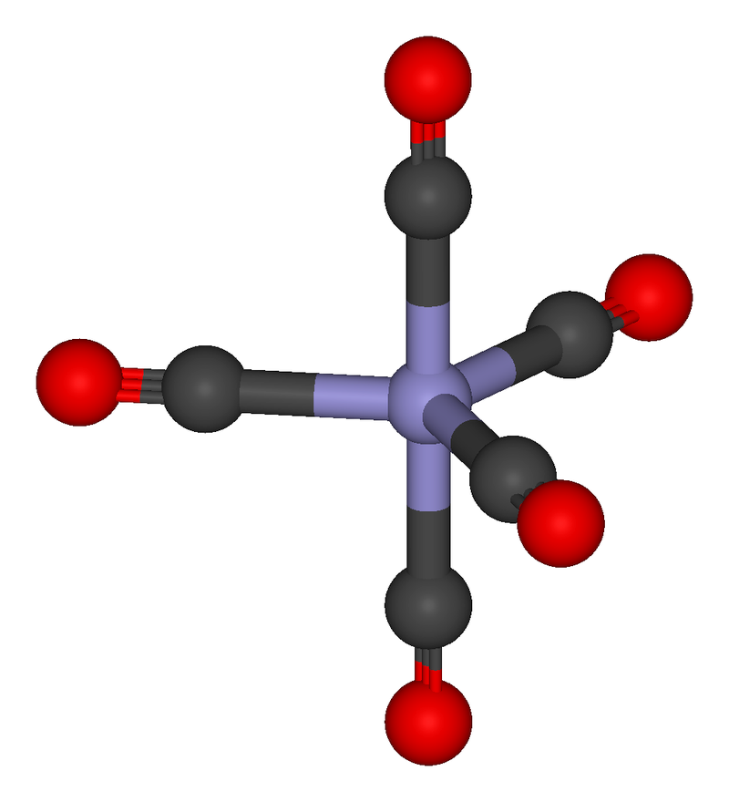
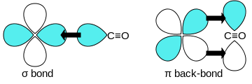
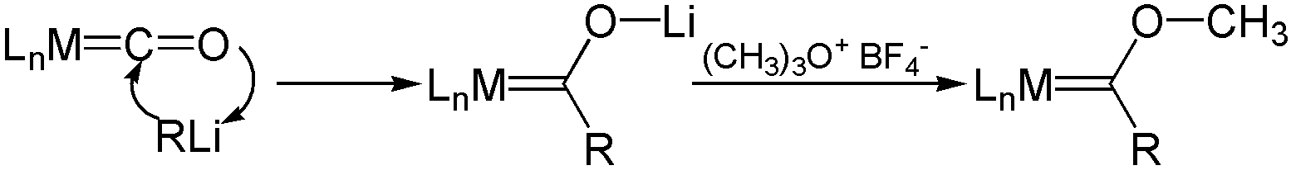
Carbonyl complexes
Carbon atom:
σ-donor = dative bond , π-acceptor = back bonding
Synergistic effect
Applications in Organometallic Chemistry

Slide 6
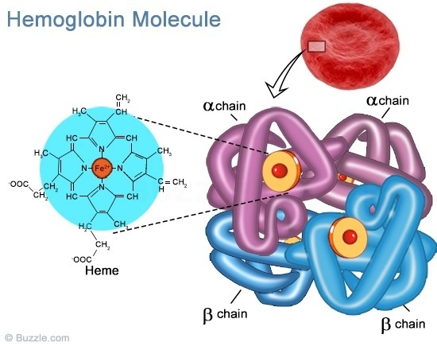
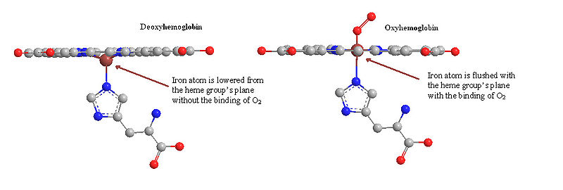
Why is CO a poisonous gas?
Hemoglobin (Hb): Transports O₂ and CO₂ in blood
Porphyrin
Fe²⁺
distal
histidine
O₂-Hb, CO₂-Hb: Reversible
CO-Hb: Almost ireversible,
half life of several hours
https://en.wikipedia.org/wiki/Hemoglobin

Slide 7
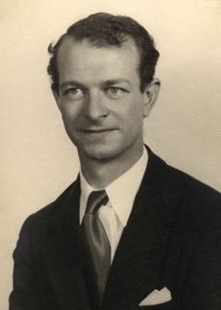
Linear combination of atomic orbitals within an atom leading to more effective bonding
Hybridization
2p_{z}
2p_{x}
2p_{y}
2p_{x}
2p_{y}
γ 2s+δ 2p_{z}
α 2s+β 2p_{z}
2s
The coefficients α, β, γ and δ depend on field strength
Square of a coefficient = contribution of that AO in the hybrid orbital
Equivalent hybrid orbitals (same s-contribution, same p-contribution in each hybrid orbital) have same energies
Hybrid orbitals are ortho-normal to each other
Hybridization origintes in VBT and relies on experimental results

Slide 8
Heteronuclear Diatomics: CO
π-acceptor
σ∗
p_{x}, p_{y}
π∗
2p
2s
h2
p_{x}, p_{y}
σ_{nb}
2p
2s
h1
π
h4
σ
h3
σ_{nb}
σ-donor
C
O

Slide 9
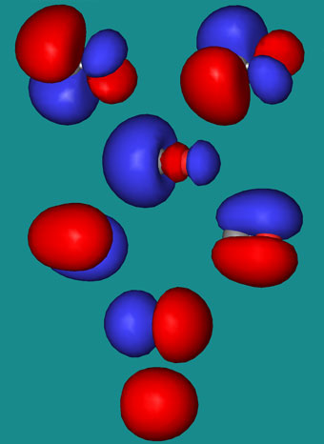
http://www.meta-synthesis.com/webbook/39_diatomics/diatomics.html
Heteronuclear Diatomics: CO
π-acceptor
σ∗
p_{x}, p_{y}
π∗
2p
2s
h2
p_{x}, p_{y}
σ_{nb}
2p
2s
h1
π
h4
σ
h3
σ_{nb}
σ-donor
C
O

Slide 10
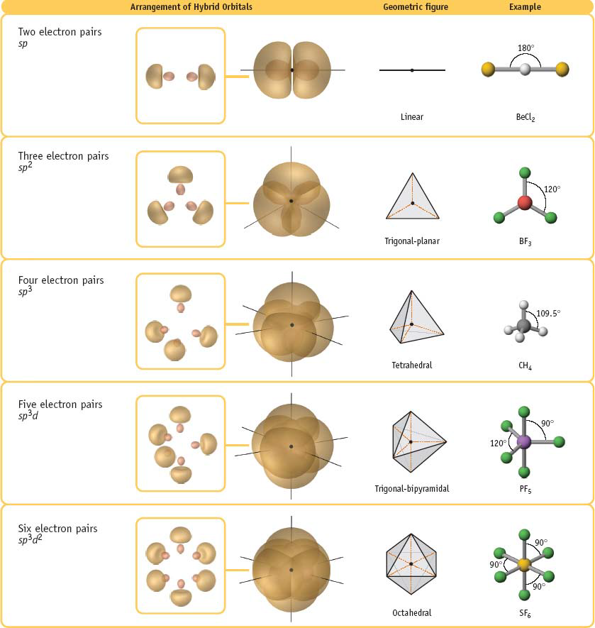
Polyatomic molecules: Geometry

Slide 11
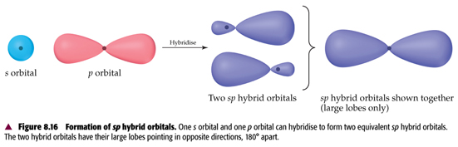
s+p (sp) hybridization
s and p orbital of the SAME atom!
No question of S (overlap integral)
2 equivalent hybrid orbitals of the same energy and shape (directions different)
Linear geometry with
Hybridized atom at the center
Contribution from s = 0.5; contribution from p = 0.5

Slide 12
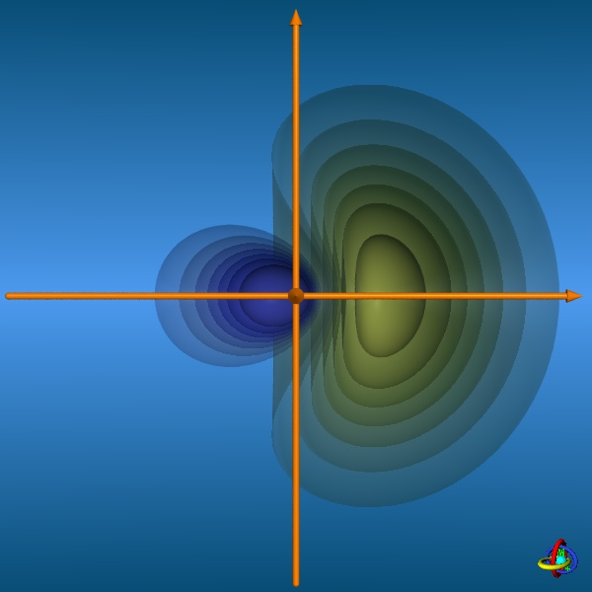
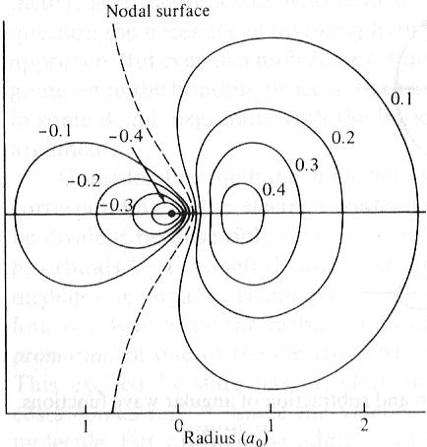
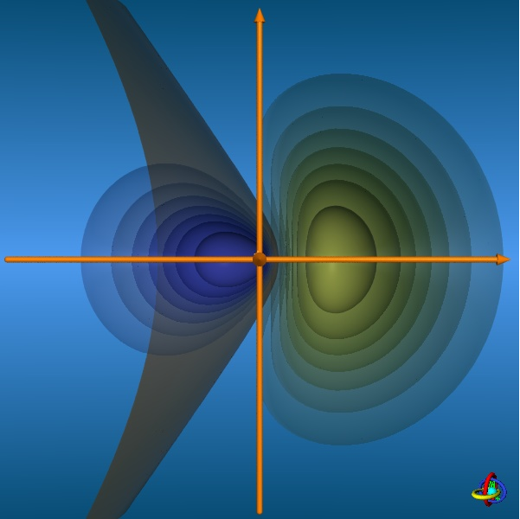
Contours of a sp hybrid orbital
http://csi.chemie.tu-darmstadt.de/ak/immel/script/redirect.cgi?filename=http://csi.chemie.tu-darmstadt.de/ak/immel/tutorials/orbitals/

Slide 13
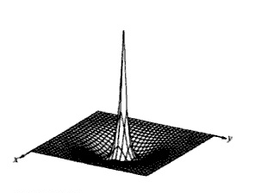
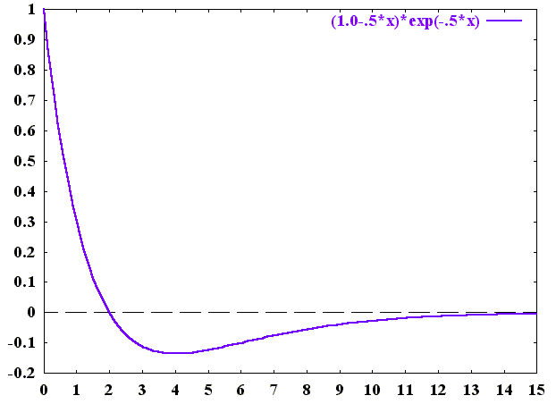
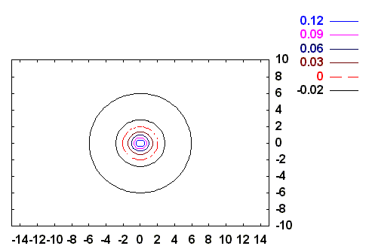
2s orbital
radial node
Y. U. Sasidhar

Slide 14
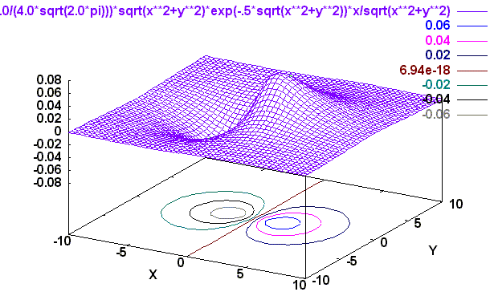
2p_{z} orbital
Angular Part
(2,1,0)
X
Z

Slide 15
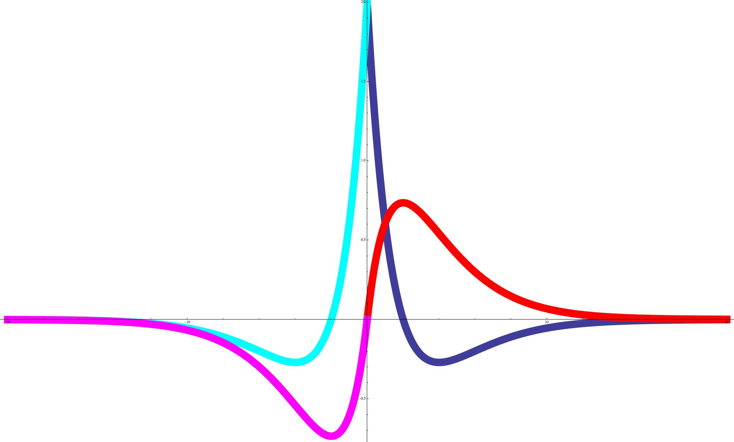
Sections of the orbitals
2s
2s
2p_{z}
2s
2p_{z}
2s

Slide 16
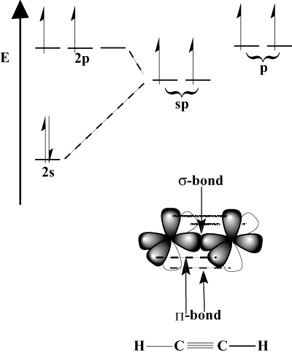
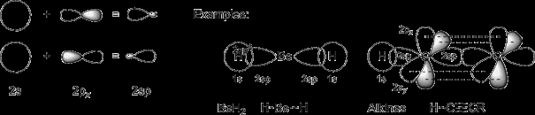
Bonding using sp hybrid orbitals
The other p orbitals are available for π bonding

Slide 17
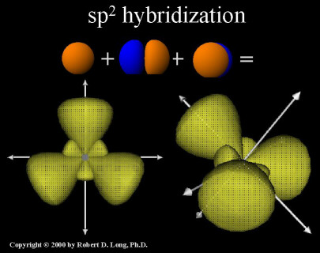
Trigonal geometry: Mixing s & two p orbitals
p_{x} and p_{y} can be combined with s to get three 3 equivalent hybrids at 120º to each other
+y
hy1
Θ₃
Θ₁
-x
+x
hy3
Θ₂
-y
hy2

Slide 18
Coefficients of AOs for specifically oriented sp² hybrid orbitals
30º
+y
+y
h1
+y
+x
+x
30º
30º
30º
+x
h2
h3

Slide 19
Coefficients from the conditions of Orthonormality
30º
h1
+y
30º
h3
+x
h2

Slide 20
Coefficients from the conditions of Orthonormality
30º
h1
+y
30º
h3
+x
h2

Slide 21
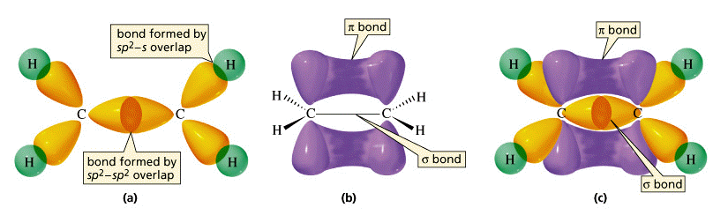
Signs and coefficients for these particular sp² hybrids
30º
h1
+y
30º
h3
+x
h2
Square of coefficients ➔ Contribution from s=0.33; from p=0.66

